Slide 1
Evolutionary Computing
Chapter 10
Hybridisation with Other Techniques: Memetic Algorithms

Slide 2
Hybridisation & Memetic Algorithms
Hybridisation: what, why and where
Memes and memetic Algorithms
Local Search, Lamarckian vs. Baldwinian adaptation
Boltzmann selection and Simulated Annealing
Operator choice
Example: Knapsack Problem

Slide 3
Hybridisation: what and why
Hybridisation: combination of an EA with another (type of) problem solving heuristic
Might be looking to improve EA search for good solutions
Might be looking to improve on existing techniques but not re-invent wheel
Might want to put in EA as part of larger system

Slide 4
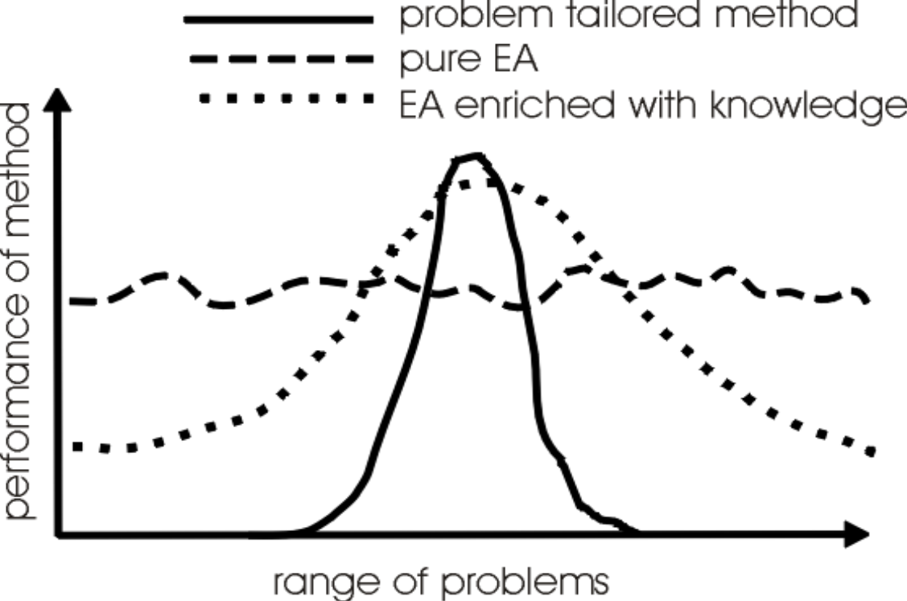
Michalewicz’ view on EAs in context

Slide 5
What is a Memetic Algorithm?
What is a meme?
The combination of an Evolutionary Algorithm with Local Search Operators that work within the EA loop has been termed “Memetic Algorithms”
Term also applies to EAs that use instance-specific knowledge in operators
Memetic Algorithms have been shown to be orders of magnitude faster and more accurate than EAs on some problems, and are the state of the art on many problems

Slide 6

What is a meme?
The newest “self-replicator” on Earth
That what is being imitated
Information copied from person to person
See
The book Susan Blackmore, The Meme Machine, Oxford University Press, 1999
Susan Blackmore’s TED talk on Memes and “temes”
https://www.ted.com/talks/susan_blackmore_memes_and_temes

Slide 7
Where to hybridise
Known solutions
Constructive heuristics
Selective initialisation
Local search
Initial population
Mating pool
Use of problem specific information in operator
Crossover
Offspring
Local search
Use of problem specific information in operator
Mutation
Offspring
Local search
Selection
Modified selection
operator

Slide 8
Heuristics for Initialising Population
For each individual in initial population: n-tournament amongst randomly created candidate solutions
NOT the same as taking the best popsize of n x popsize random points
Multi-Start Local Search: pick popsize points at random, do some hill-climbing from these, seed initial population with the resulting points
Constructive Heuristics often exist

Slide 9
Initialisation Issues
Archive approach:
initialise population with solutions already known or found by another technique
warning: performance may appear to drop at first if local optima on different landscapes do not coincide
Surry & Radcliffe (1994) studied ways of “inoculating” population with solutions gained from previous runs or other algorithms/heuristics
found mean performance increased as population was biased towards known solutions,
but best performance came from more random solutions

Slide 10
“Intelligent” Operators
It is sometimes possible to incorporate problem or instance specific knowledge within crossover or mutation operators
Crossover example: Merz’s DPX operator for TSP inherits common sub tours from parents, then connects them using a nearest neighbour heuristic
Mutation example in Smith (‘97) for evolving microprocessor instruction sequences: group instructions (alleles) into classes so mutation is more likely to switch gene to value having a similar effect
Many other problem specific examples in literature

Slide 11
Local Search Acting on Offspring
Can be viewed as a sort of “lifetime learning”
Lots of early research done using EAs to evolve the structure of Artificial Neural Networks and then Back-propagation to learn connection weights
Often used to speed-up the “endgame” of an EA by making the search in the vicinity of good solutions more systematic than mutation alone

Slide 12
Local Search and graphs: Local Search
Defined by combination of neighbourhood and pivot rule
Neighbourhood N(x) of point x is the set of points that can be reached from x with one application of a move operator (this is an “operational” definition)
e.g. bit flipping search on binary problems
Pivot rule: condition for stopping neighbourhood search, e.g., greedy ascent
g
h
d
d = (1,0,1)
c = (0,0,1)
h = (1,1,1)
a = (1,0,0)
N(d) = {a,c,h}
c
f
e
b = (0,0,0)
a

Slide 13
Local Search and graphs: Landscapes & Graphs
The combination of representation and operator defines a graph G(V,E) on the search space (useful for analysis), where
V, the set of vertices, is the set of all points that can be represented (the potential solutions)
E, the set of edges, is the possible transitions that can arise from a single application of the search operator
Note that the edges in E can have weights attached to them, and that they need not be symmetrical

Slide 14
Example Graphs for Binary Problems
Example : 3 dimensional binary problem as above
V = {a,b,c,d,e,f,g,h,}, e.g., b = (0,0,0),
Search by flipping each bit in turn
E₁ = { ab, ad, ae, bc, bf, cd, cg, dh, fg, fe, gh, eh} 1 bit-flip
symmetrical and all values equally likely
E₂ = {ac,bd,af,be,dg, ch, fh, ge, ah, de, bg, cf} 2 bit-flips
E₃ = {ag, bh, ce, df} 3 bit-flips
Bit flipping mutation with prob p per bit implies weights for edges
g
h
c
d
f
e
b
a

Slide 15
Local Search and graphs: Graphs
The degree of a graph is the maximum number of edges coming into/out of a single point - the size of the biggest neighbourhood
single bit changing search: degree is L (lengh of the bit vector)
bit-wise mutation on binary: degree is 2^{L} -1
2-opt: degree is O(N²)
Local Search algorithms look at points in the neighbourhood of a solution, so complexity is related to degree of graph

Slide 16
Local Search and graphs: Pivot Rules
Overall strategy: is the neighbourhood searched randomly, systematically or exhaustively ?
Stopping condition:
Greedy Ascent: stop as soon as a fitter neighbour is found
Steepest Ascent: stop after the whole set of neighbours examined and choose the best
No one best answer in general, but some are quicker than others to run ...

Slide 17
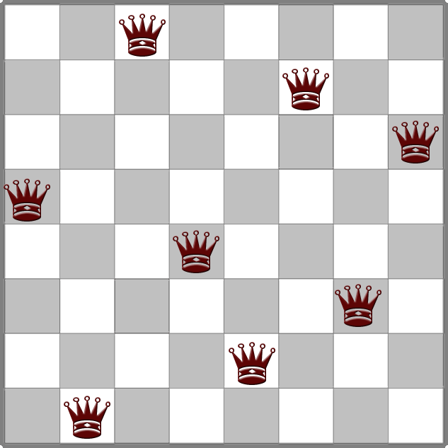
Variations of Local Search
Variants by, for instance:
Where does the search happen, in representation space (genotype space) or solution space (phenotype space)?
Exercise@home: give an example for both (hint: 8queens)
Question: (dis)advantages of the phenotype option?
How many iterations of the local search are done ?
Is local search applied to the whole population?
or just the best ?
or just the worst ?
or at random ?

Slide 18
Two Models of Lifetime Adaptation
Lamarckian
https://en.wikipedia.org/wiki/Lamarckism
traits acquired by an individual during its lifetime can be transmitted to its offspring
EA implementation: replace individual with fitter neighbour (thus: use another genotype)
Baldwinian
traits acquired by individual cannot be transmitted to its offspring
EA implementation: individual receives the fitness of fitter neighbour (but keeps its own genotype)

Slide 19
Baldwin vs. Lamarck
LOTS of work has been done on this
the central dogma of genetics is that traits acquired during an organisms lifetime cannot be written back into its gametes
epigenetics provides extra nuance
In MAs we are not constrained by biological realities so we can do Lamarckism
Recent work in evolutionary robotics: Lamarckism is better!

Slide 20
Information Use in Local Search
Most Memetic Algorithms use an operator acting on a single point, and only use that information
However this is an arbitrary restriction
Jones (1995), Merz & Friesleben (1996) suggest the use of a crossover hillclimber which uses information from two points in the search space
Krasnogor & Smith (2000) - see later - use information from whole of current population to govern acceptance of inferior moves
Could use Tabu search with a common list

Slide 21
Diversity
Local search pushes strongly towards better points → is subject to quickly losing diversity
Some successful algorithms explicitly use mechanisms to preserve diversity:
Merz’s DPX crossover explicitly generates individuals at same distance to each parent as they are apart
Krasnogor’s Adaptive Boltzmann Operator uses a Simulated-Annealing like acceptance criterion where “temperature” is inversely proportional to population diversity

Slide 22
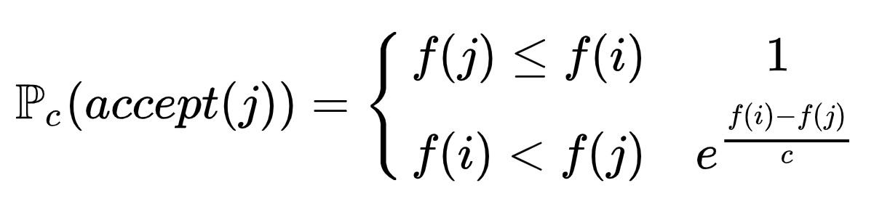
Simulated Annealing
Local search method or neighborhood search method, that is, generate and test
Generate: Some unary search/move/mutation operator steps from point/individual i to its neighbor/child j
Test: Boltzmann selection with a parameter c > 0 called temperature, c is decreased over time (“cooling” schedule)
Minimizing or maximizing?

Slide 23
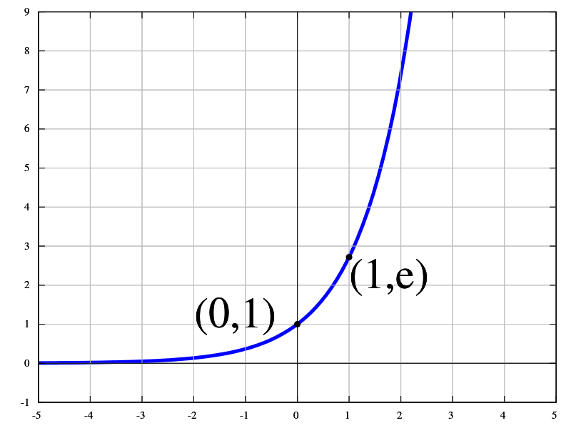
Impact of the constant c
f(i) < f(j), hence f(i) – f(j) < 0
c is large → exponent of e is small and < 0 → the term e^x is close to 1 → very likely to accept worse neighbours
c is small → exponent of e is large and < 0 → the term e^x is close to 0 → less likely to accept worse neighbours
Thus, a “cooling” schedule leads to more and more harsh selection

Slide 24
Boltzmann selection operator in an EA
Induced dynamics:
Early stage → population is diverse → f_{max} - f_{avg} is large → exponent of e is small and < 0 → the term e^x is close to 1 → Exploration
Late stage → population has converged → f_{max} - f_{avg} is small → exponent of e is large and < 0 → the term e^x is close to 0 → Exploitation

Slide 25
Choice of Operators
There are theoretical advantages to using a local search with a move operator that is DIFFERENT to the move operators used by mutation and crossover cf. Krasnogor (2002)
Can be helpful since local optimum on one landscape might be point on a slope on another
Easy implementation is to use a range of local search operators, with some mechanism for choosing which to use
Operator selection could be learned & adapted on-line

Slide 26
Adaptive Memetic Algorithm
Most important in MAs that incorporate local search or heuristic improvement is the choice of an good move/search operator
Careful consideration
Using domain-specific information
Use of multiple local search operators in tandem
Can add a gene indicating which local search operator to use (inherited from parents, subject to mutation)
Question: is there any resemblance to the logic of self-adaptive mutation step-sizes?

Slide 27
Important points
Memetic algorithm = EA hybridised with other heuristics
Best of both worlds: “blind” evolution + problem specific “intelligence”
Intelligence by known operators from other algorithms for the given problem (e.g. 2-opt for TSP)
Intelligence by domain-specific or application-specific knowledge
MAs are the “state of the art” on many problems
shown to be orders of magnitude faster and more accurate than EAs on some problems
In real world applications it is common hybridise EAs
If you can hybridise: DO IT!

Slide 28
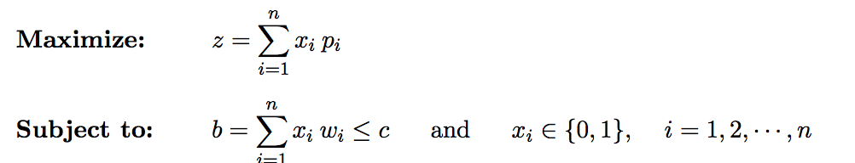
Example: Knapsack Problem
Given a knapsack with finite capacity C
Given a set of n items, where each item i is associated with a weight w_{i} and a profit p_{i} .
Goal: select a subset of items such that the total profit z is maximized, while the total weight b does not exceed the capacity of the knapsack, C.
x_{i} = 1 if chosen, 0 otherwise

Slide 29
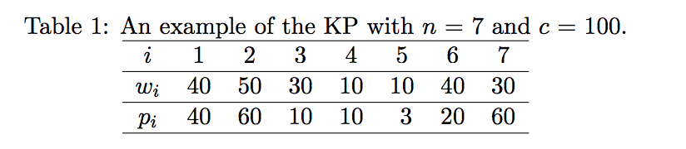
Example: Knapsack Problem
Multi-Start Local Search hill climber?
Local search method: 1 bit flip
Choose the bit flip resulting in a feasible solution with highest weight increase.
Repeat until each bit flip results in an infeasible solution
Q: What is the result when you start with 0000000?

Slide 30
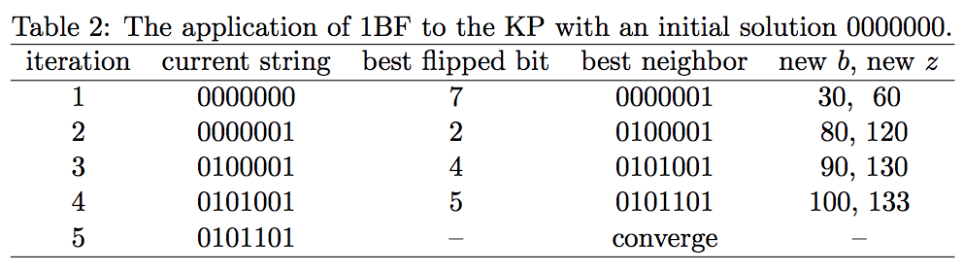
Example: Knapsack Problem

Slide 31
Example: Knapsack Problem
Local search without problem specific knowledge: first fit
Starting from initial solution, examine the inclusion of an item in the order of i=1,2,..
Item is included if there is still room for the item
Consider solution 00001000, what will the final solution be?
1100100 (b=100, z=103)

Slide 32
Example: Knapsack Problem
Local search with problem specific knowledge?
Hint: what items are important for this problem?
Low weight, high value

Slide 33
Example: Knapsack Problem
Local search with problem specific knowledge: first fit descent
Calculate for each item the ratio p_{i}/w_{i}
Sort the items in decreasing value
Add items in this order as long as there is room
Consider solution 00001000, what will the final solution be? (order: 7,2,4,1,6,3)
0101101 (b=100,z=133)
Result increased 30% w.r.t. blind approach

